Slide 1
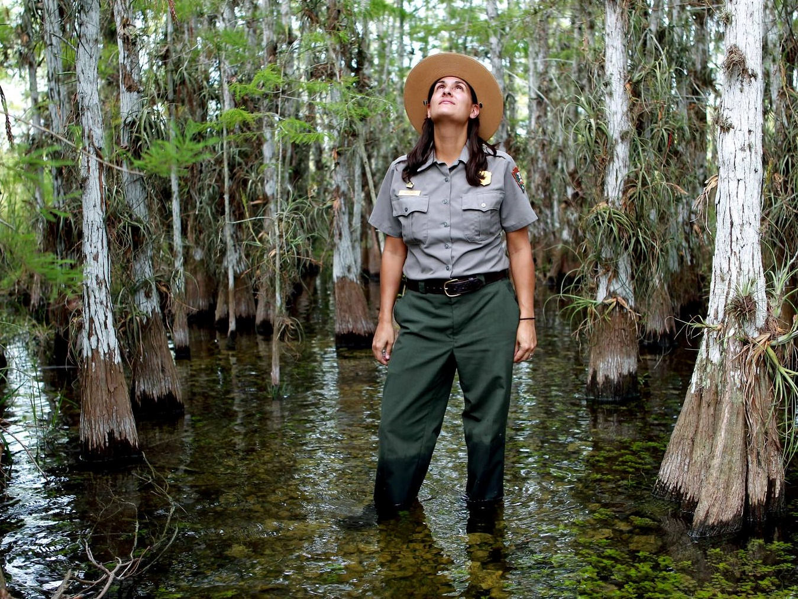
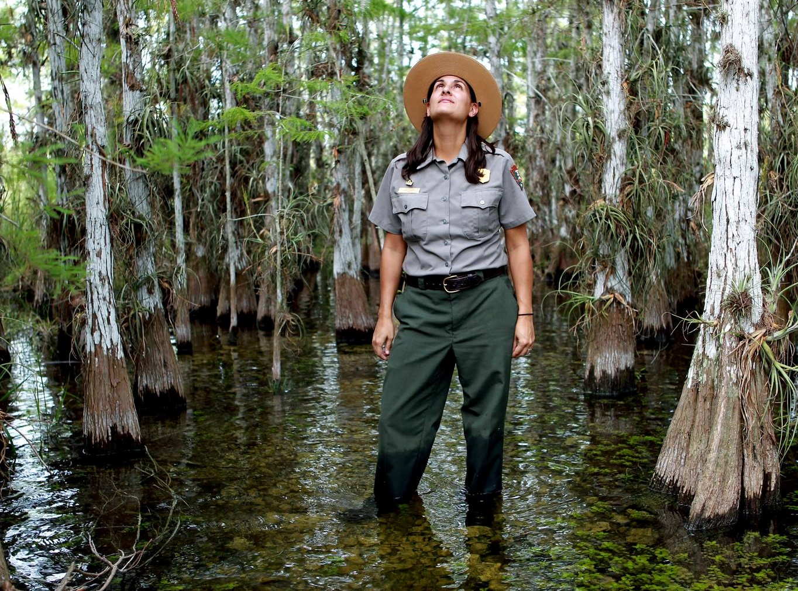
National Park Service
U.S. Department of the Interior
Everglades National Park
Dream Park Design

Slide 2
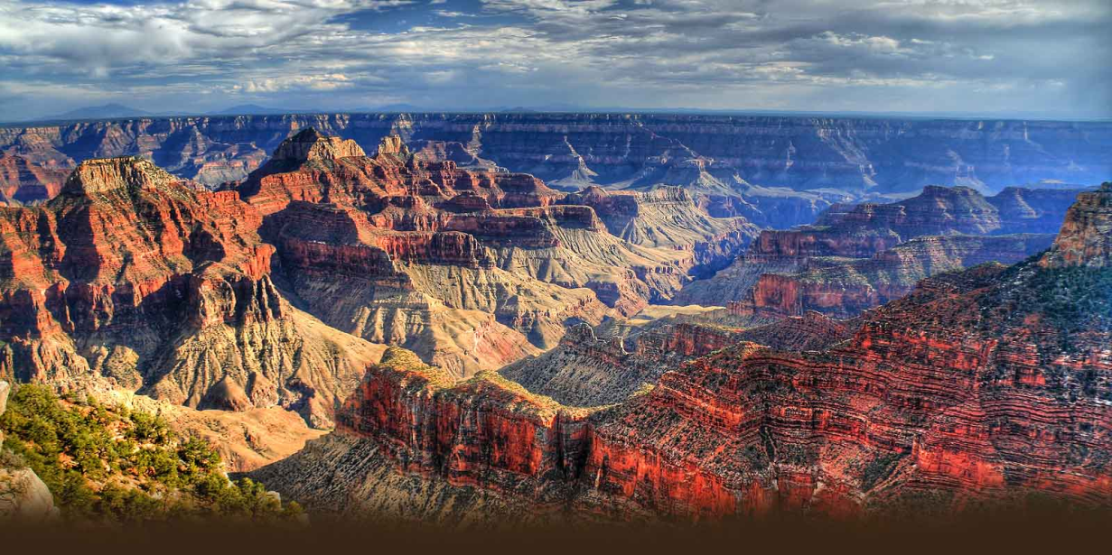
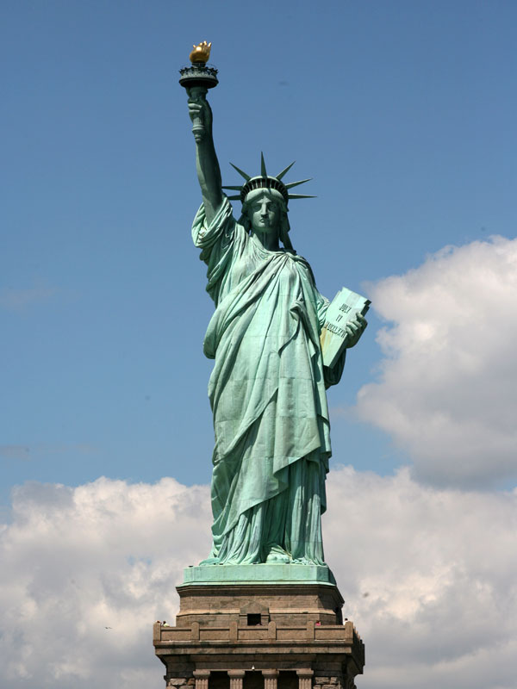
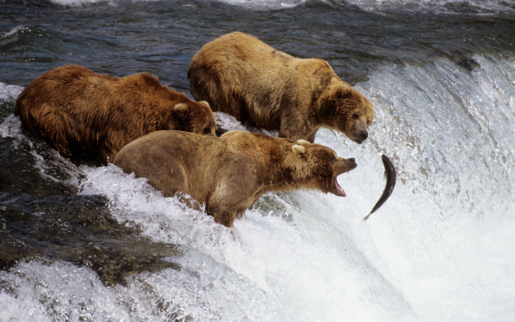
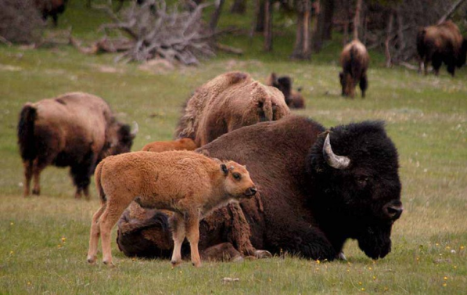
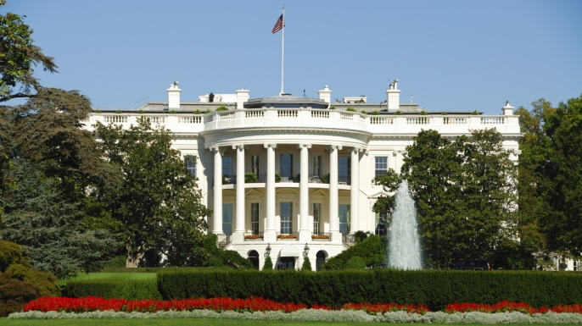
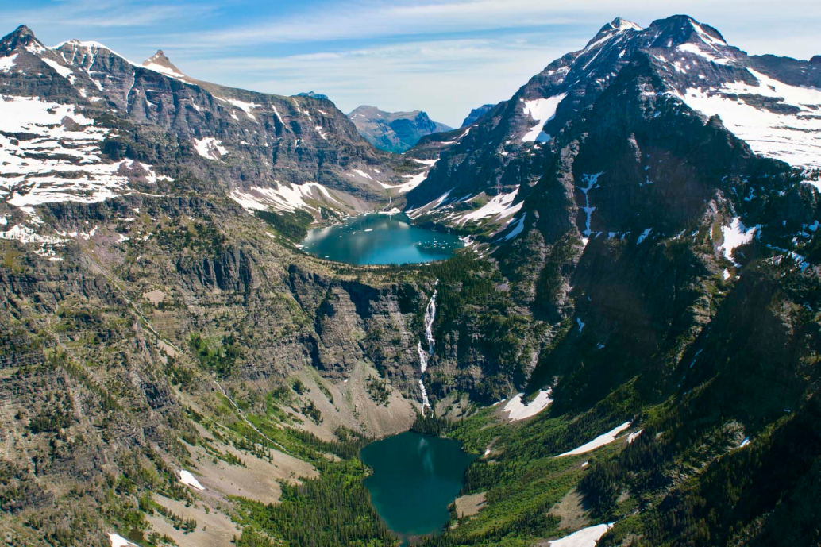
Notes:
National Parks can be all shapes and sizes!
-The arrowhead represents all that we protect and preserve.
Plantlife
Landscapes
Waterways
Wildlife
Culture / History

Slide 3
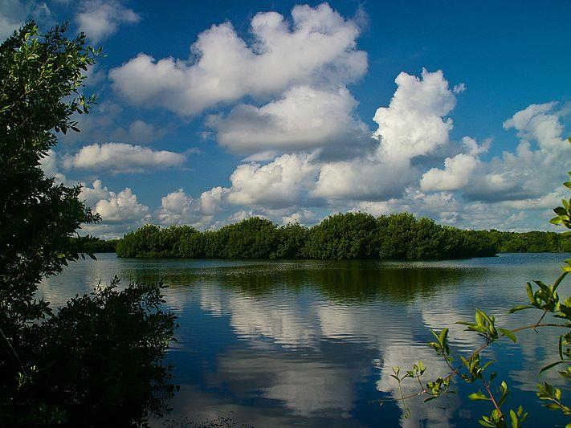
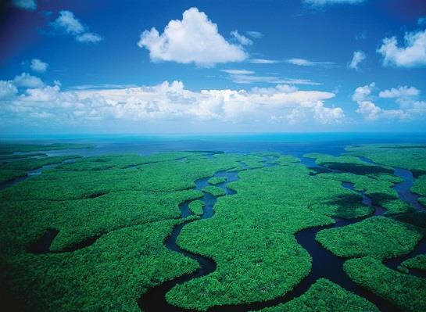
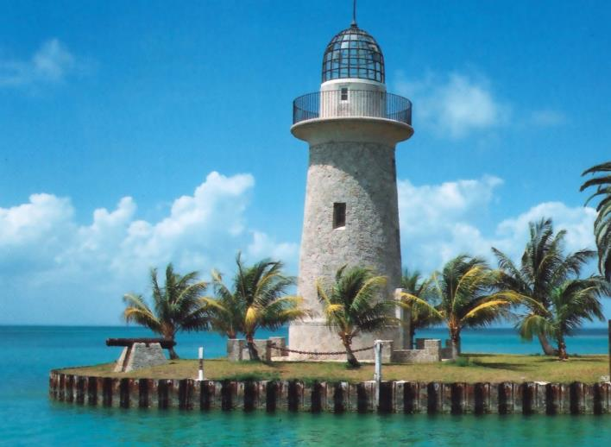
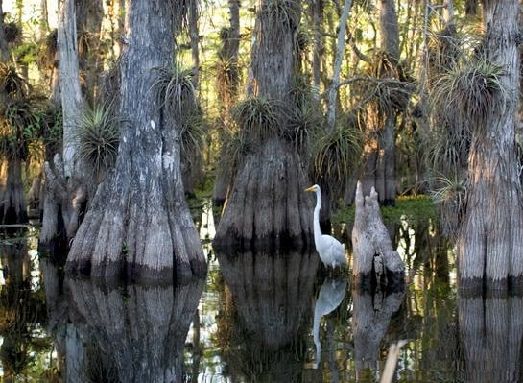
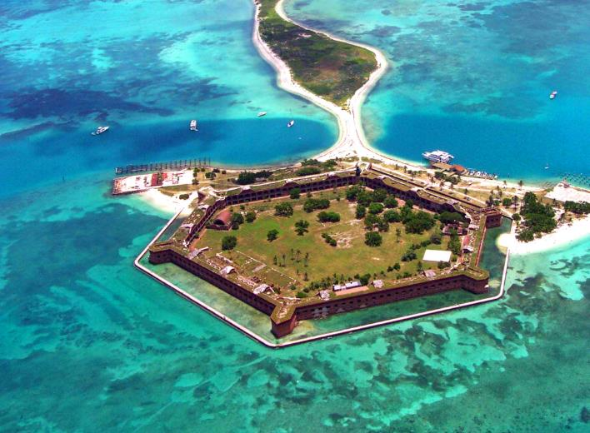
Everglades
Biscayne
South Florida National Parks
Big Cypress
Dry Tortugas

Slide 4
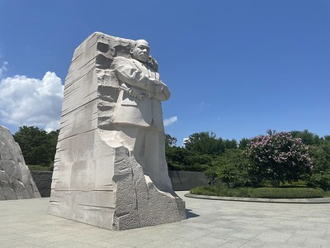
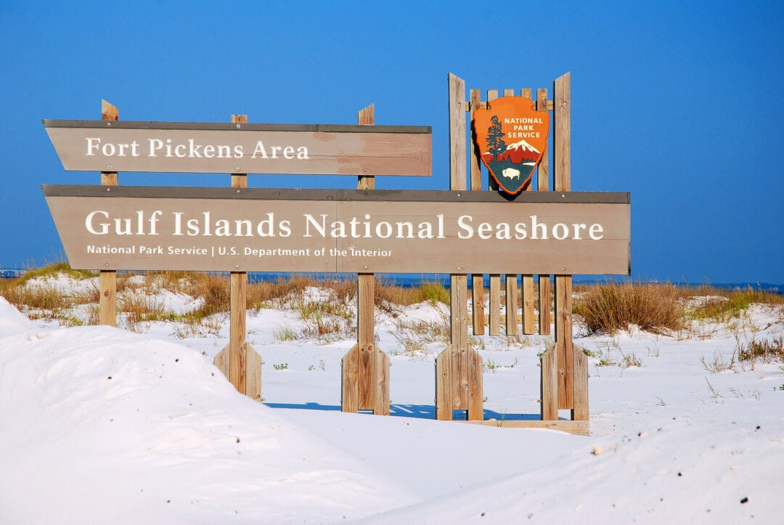
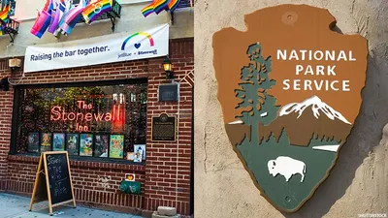
MLK Jr. Memorial
Arlington National Cemetery
Gulf Islands National Seashore
Stonewall National Monument

Slide 5
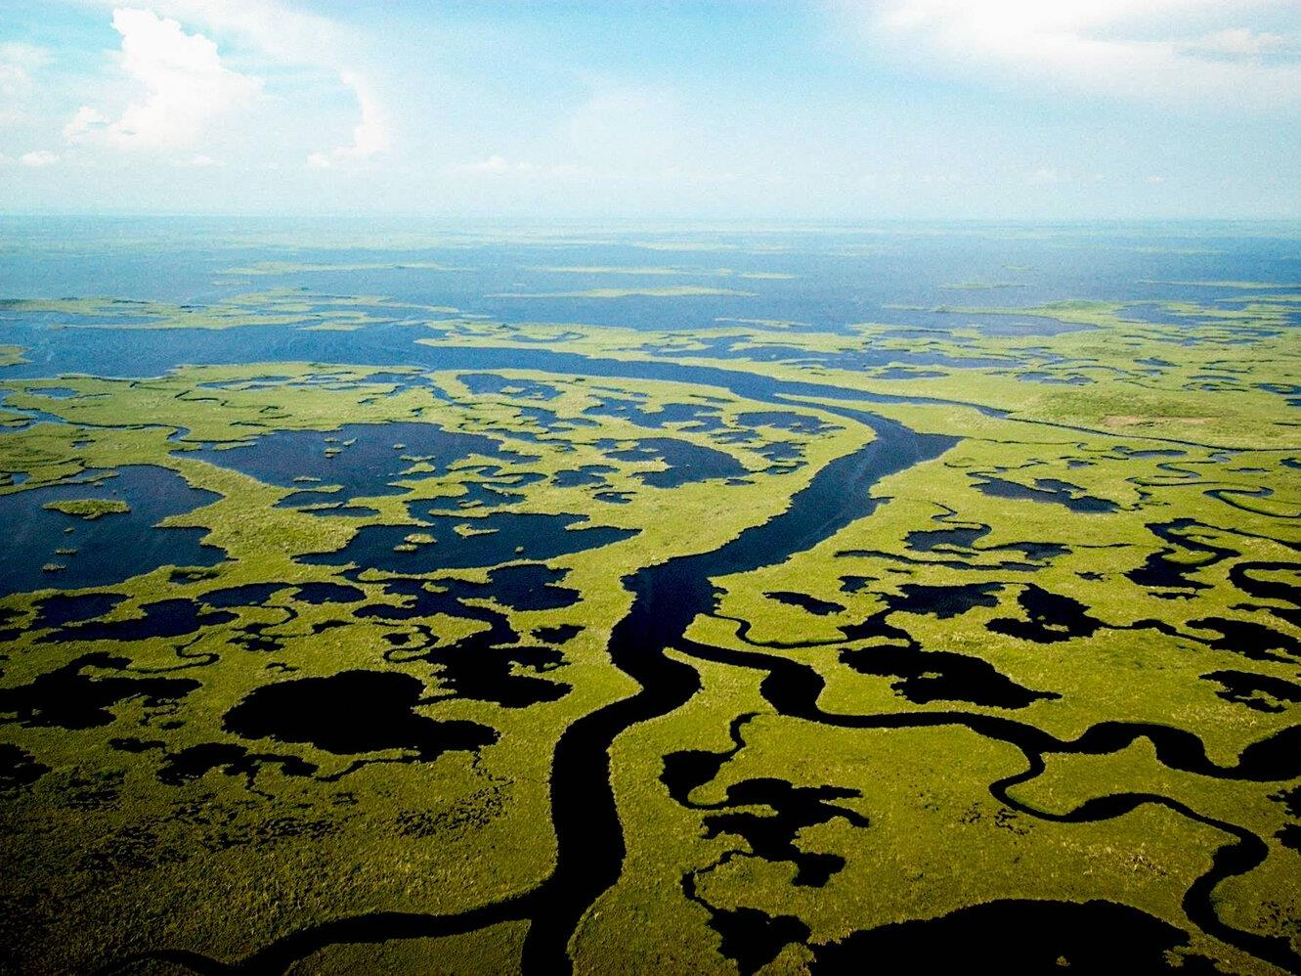
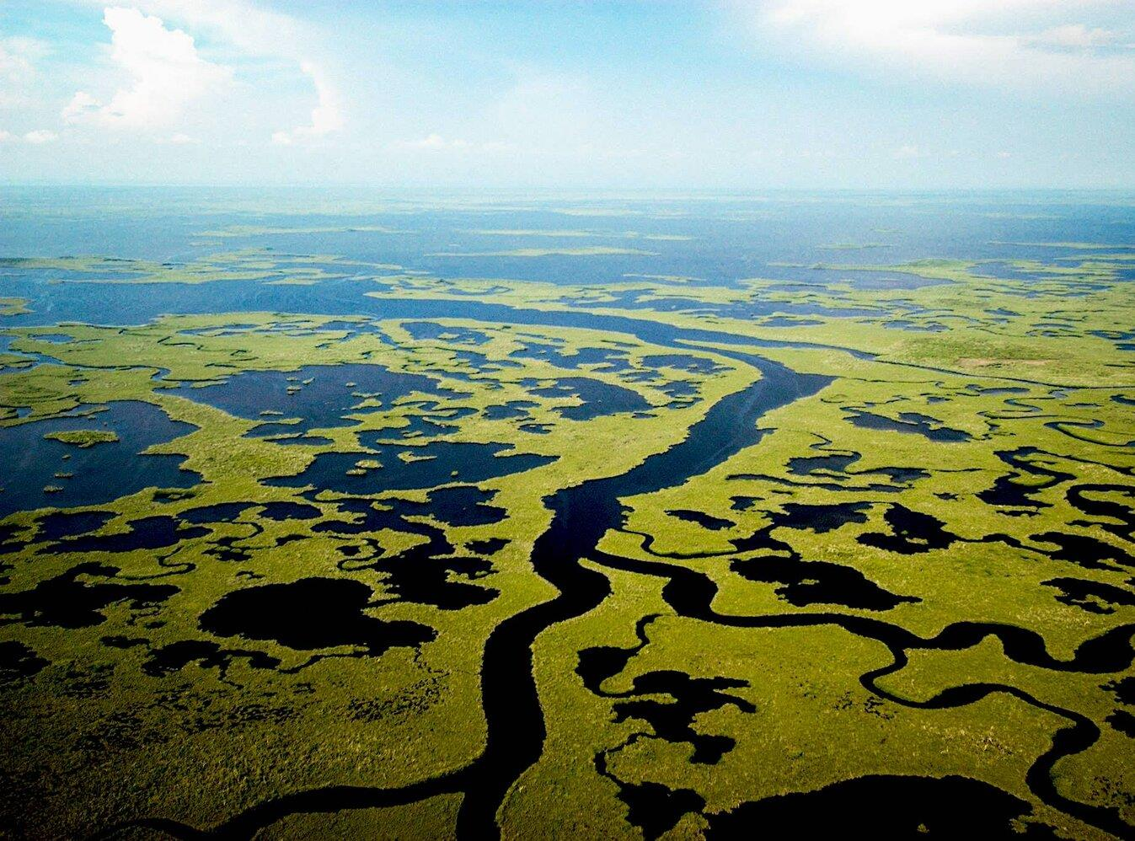
A closer look at
Everglades National Park

Slide 6
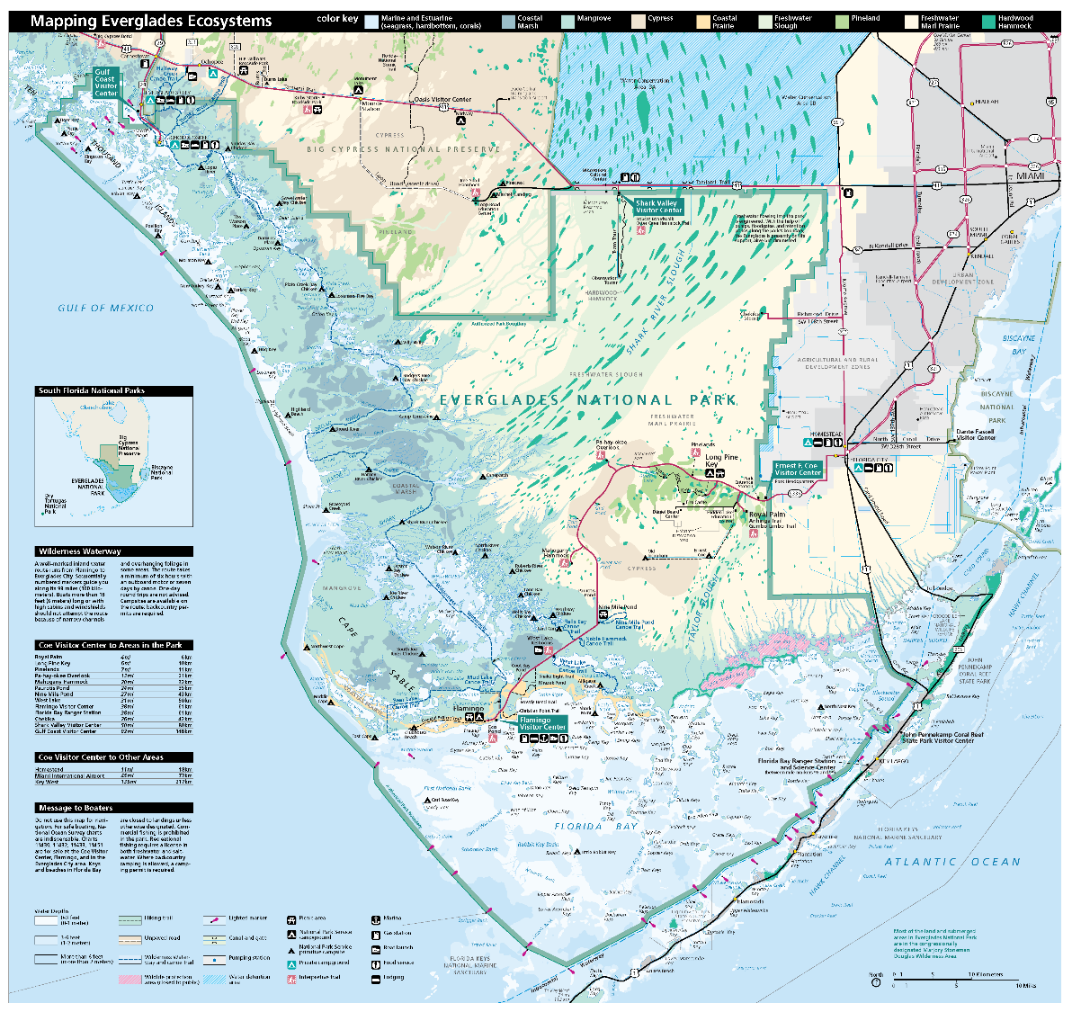

Slide 7
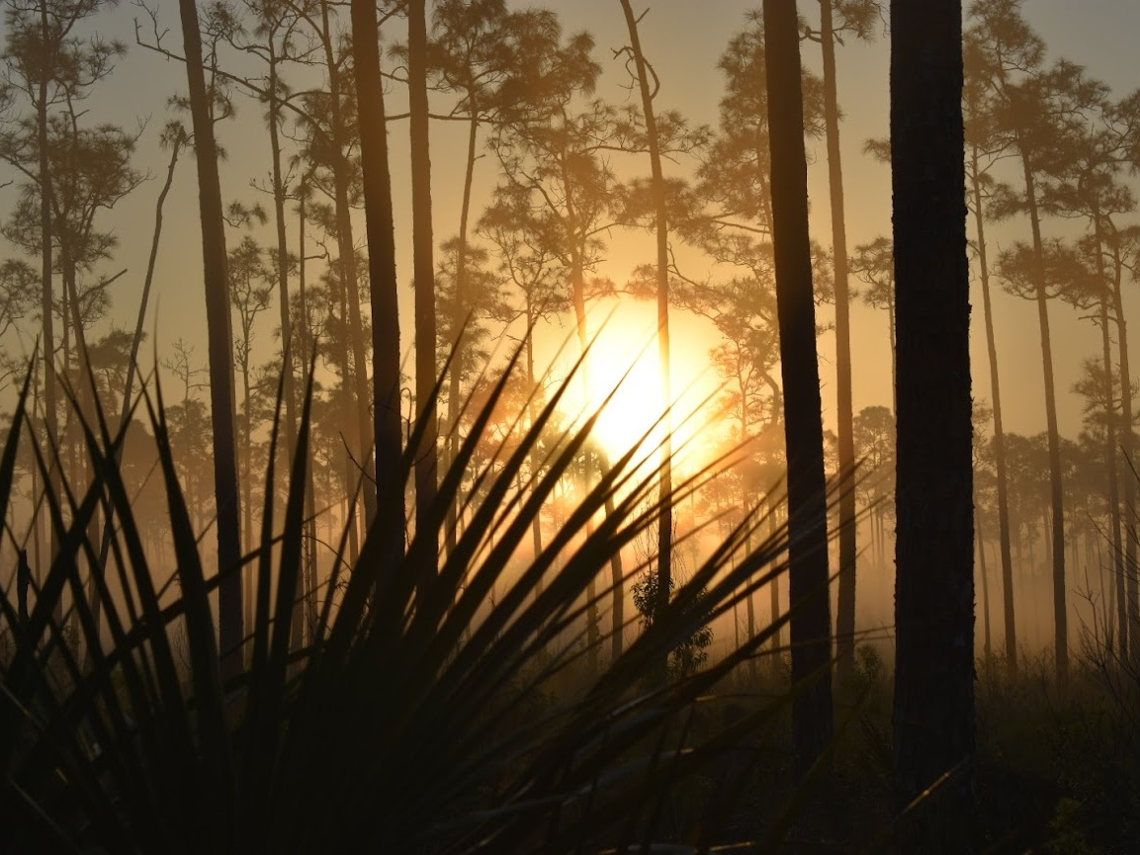
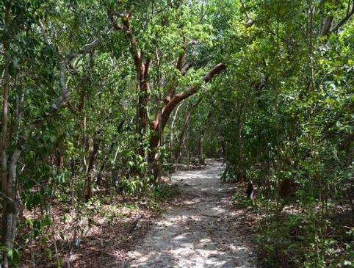
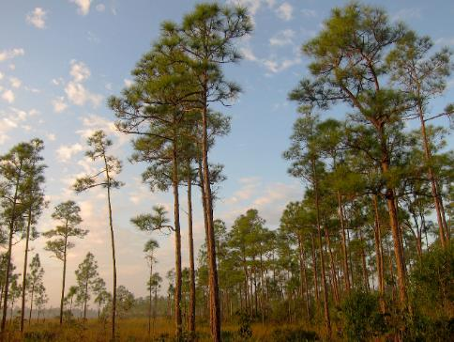
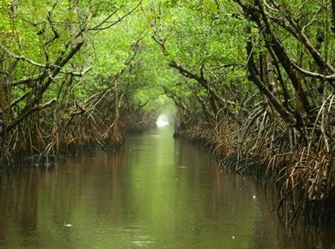
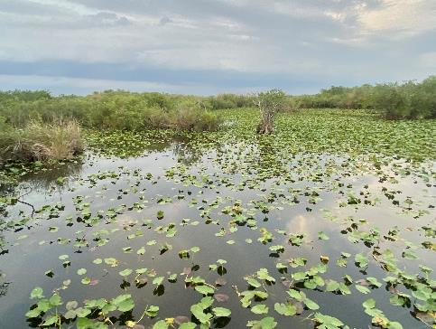
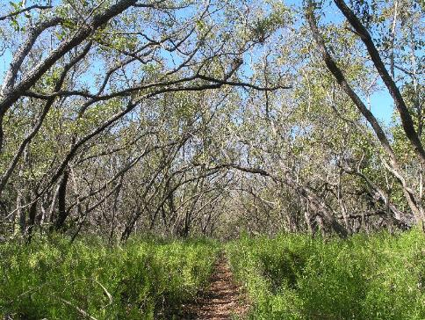
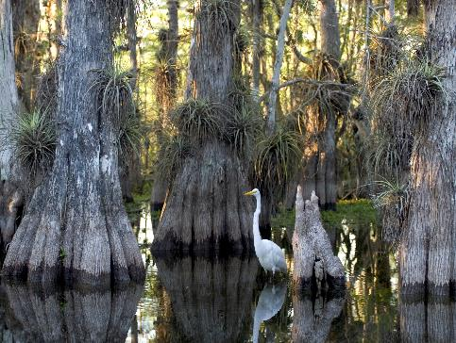
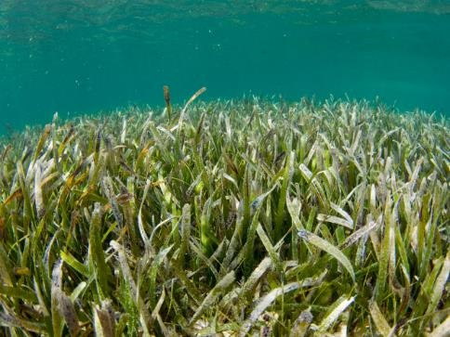
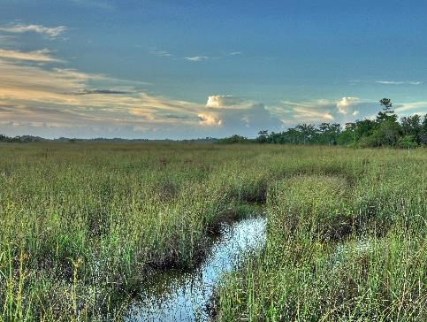
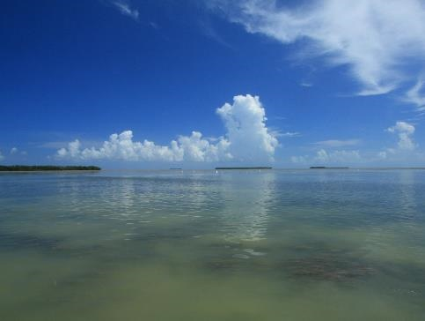

Slide 8
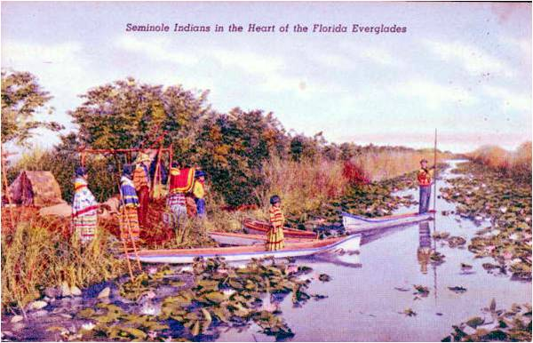
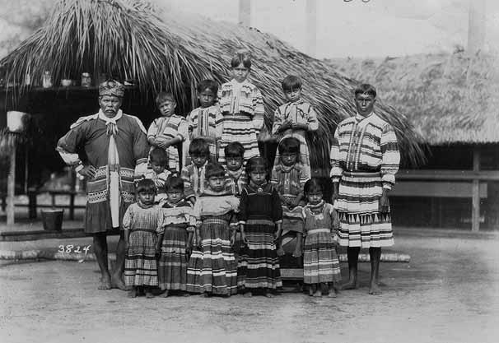

Slide 9
Jobs in the National Park
Superintendent – Final Approval
Compliance – Approval and planning of Parking Lots, Trails, Hotels/Lodges, Restaurants, etc.
Law Enforcement – Patrolling and enforcing laws.
Interpretation – Providing information at Visitor Centers, programs at trails (walking, biking, boats, etc.)
Education Rangers – School Programs
Maintenance – Responsible for mowing, building maintenance, bathroom cleanliness, repairs, trials, etc.
Concessions – A private company that runs/operates experiences for visitors within a national park.

Slide 10
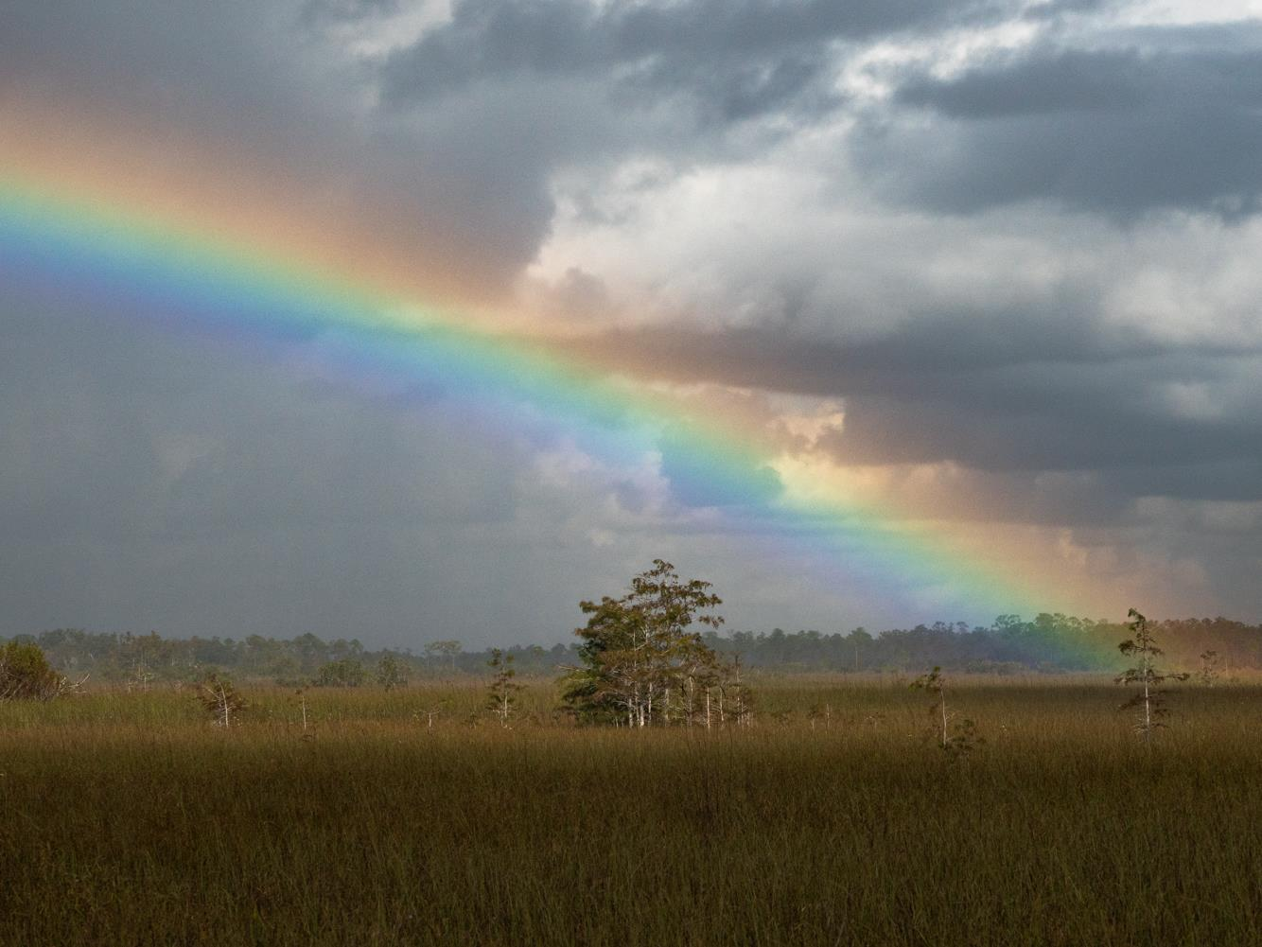
Questions?
Yvette Cano, Director of Education
Yvette_Cano@nps.gov
305-242-7753

