Slide 1
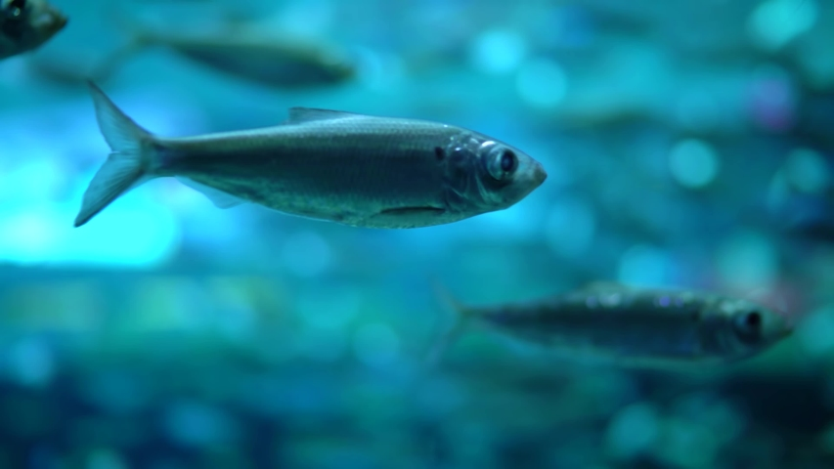
Systems Thinking: Thinking Critically About the Everglades Amy Friedrichs

Slide 2
Objectives
Brief Introduction to Systems Thinking
Play the Fish Game
Analyze Fish Game using Systems Thinking Tools
Examples of Student Work
Final Thoughts and Resources

Slide 3
“Systems”
What do you think of when you think of a system?

Slide 4
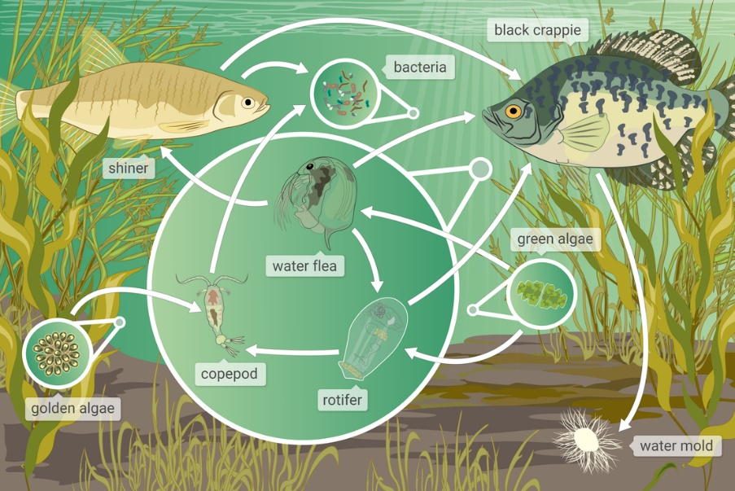
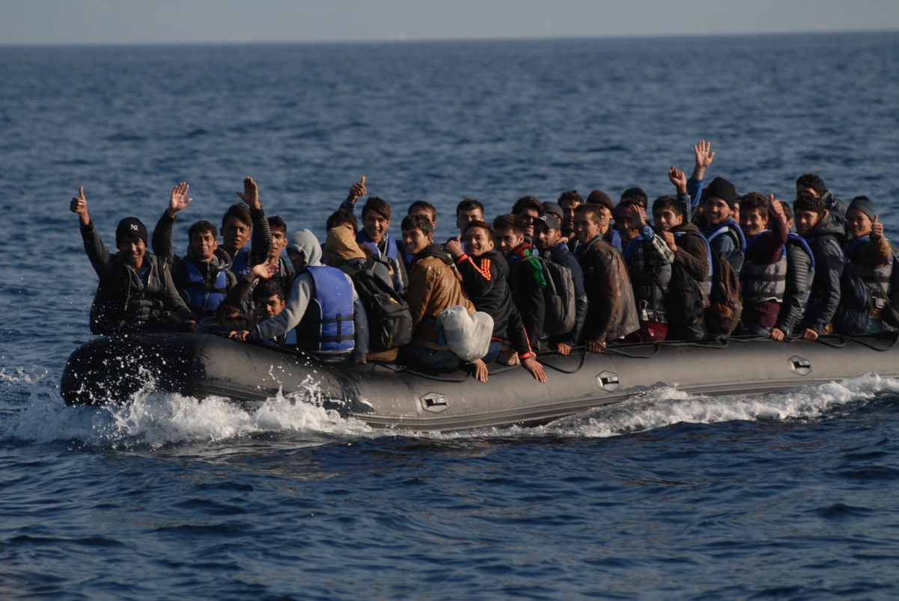
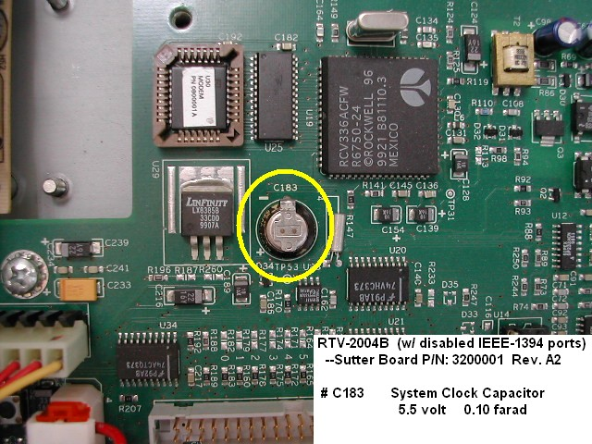
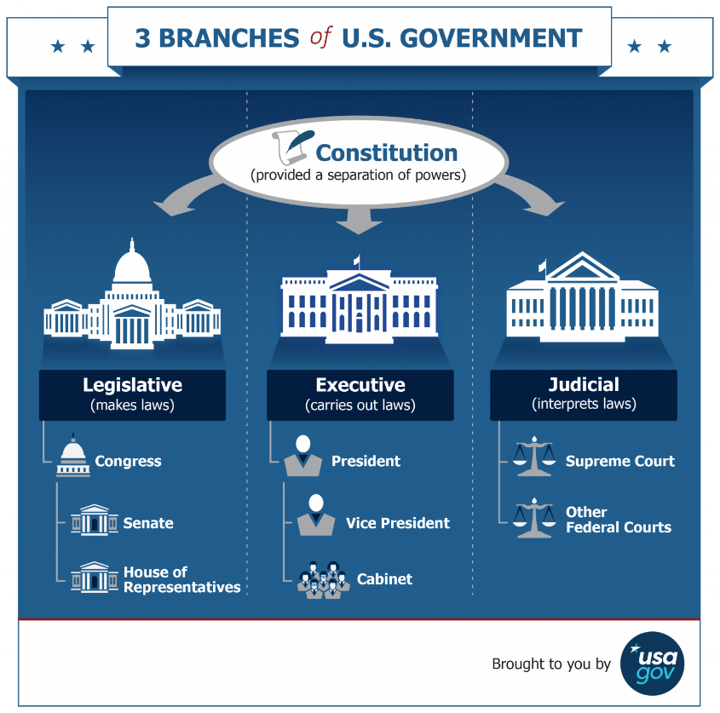
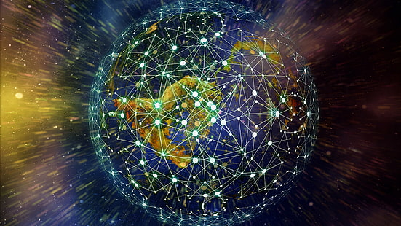
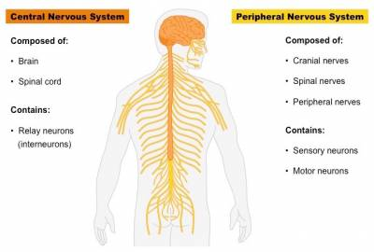
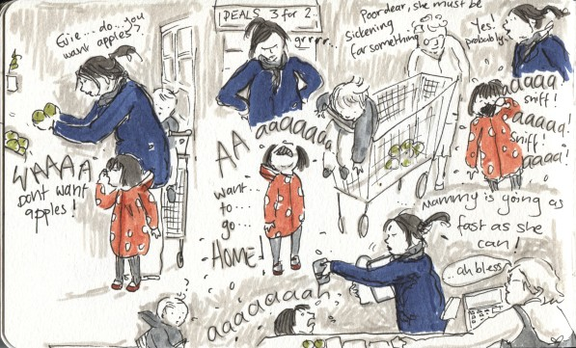
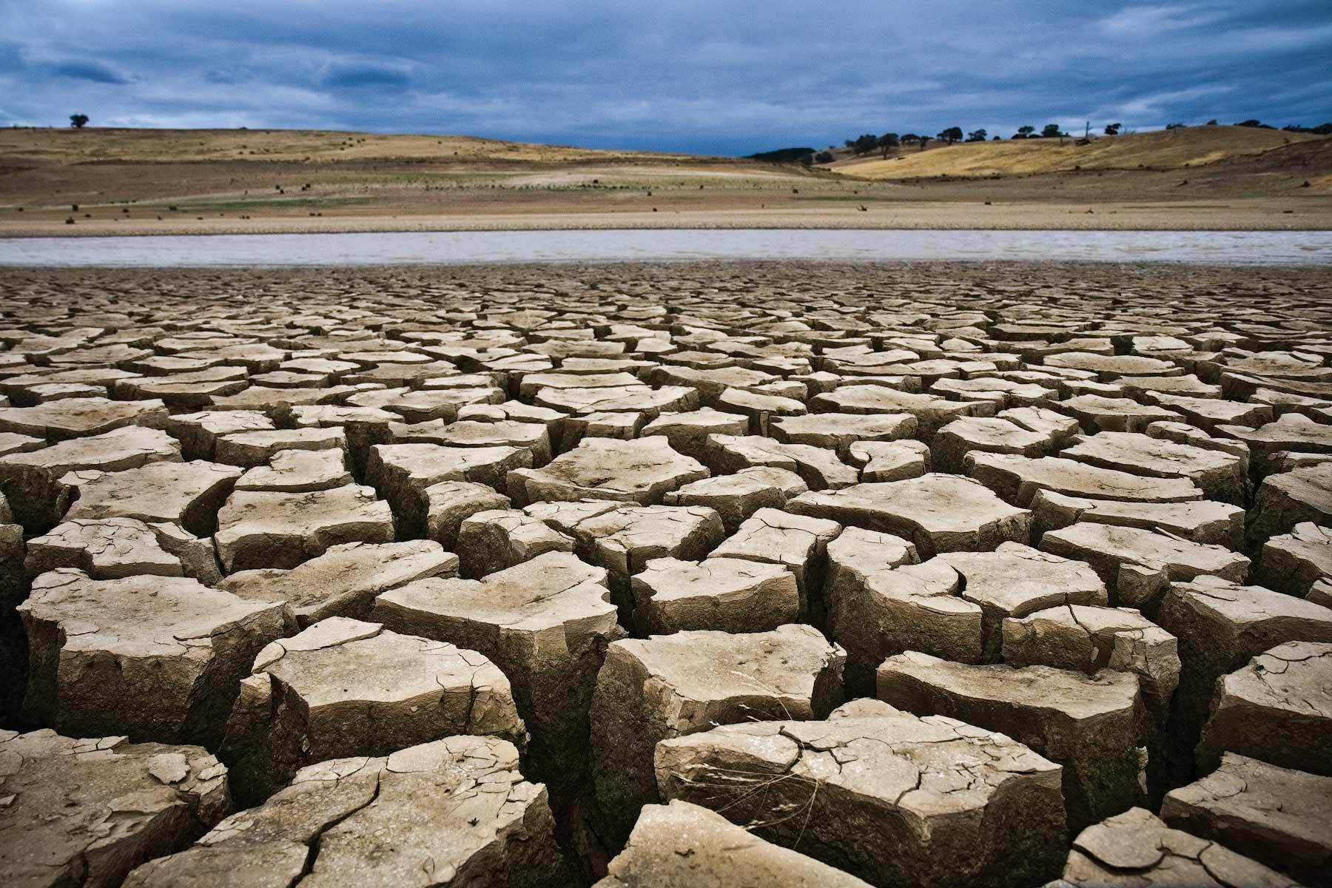
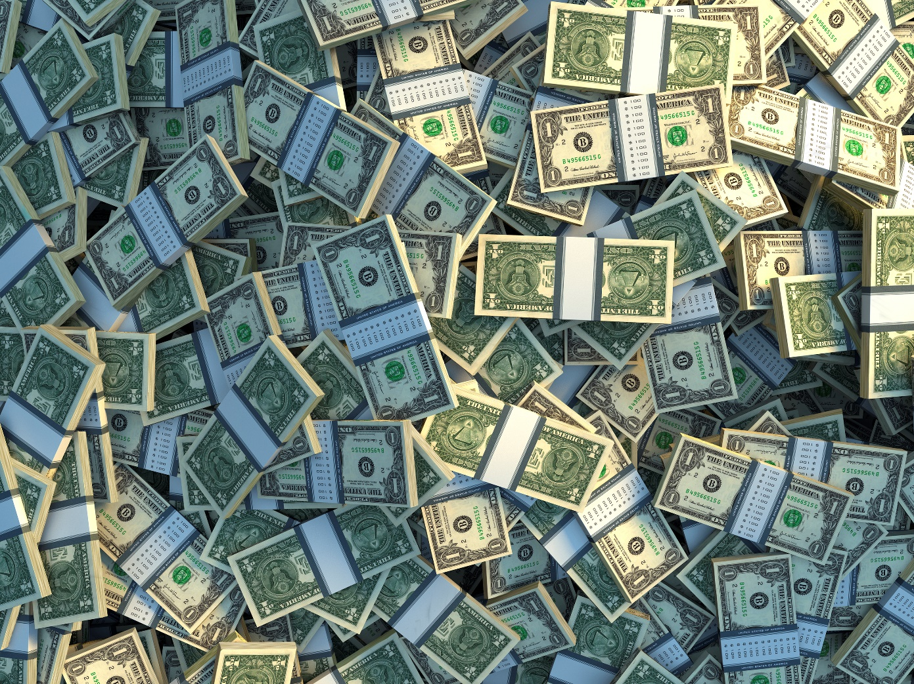
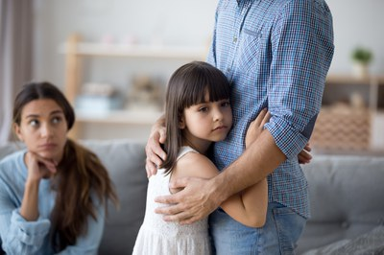
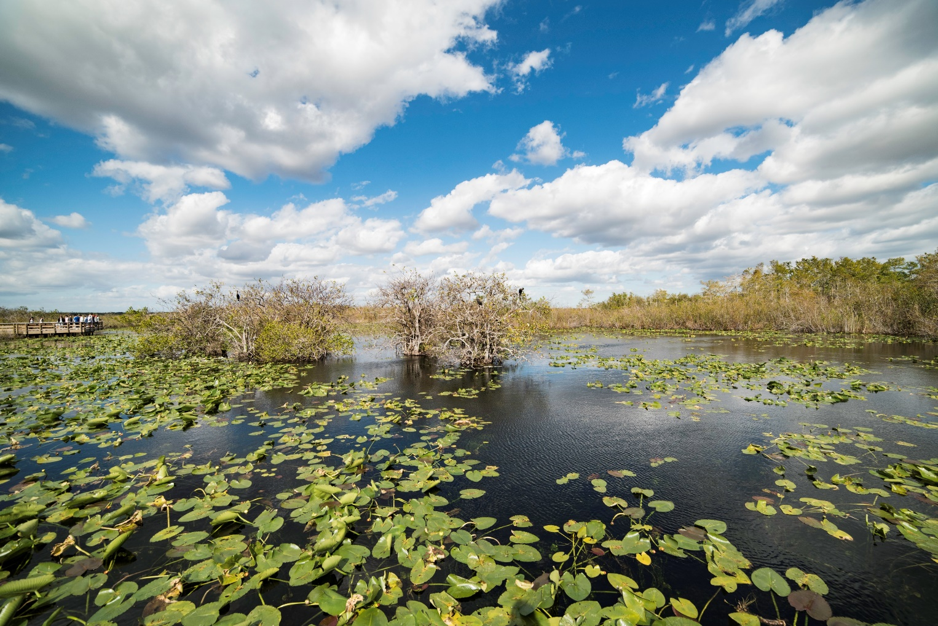
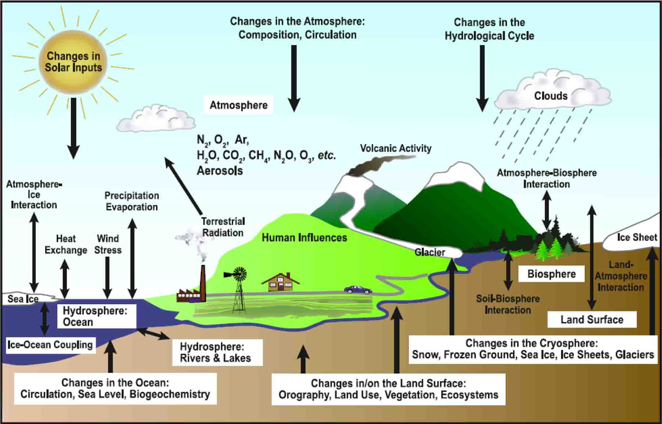
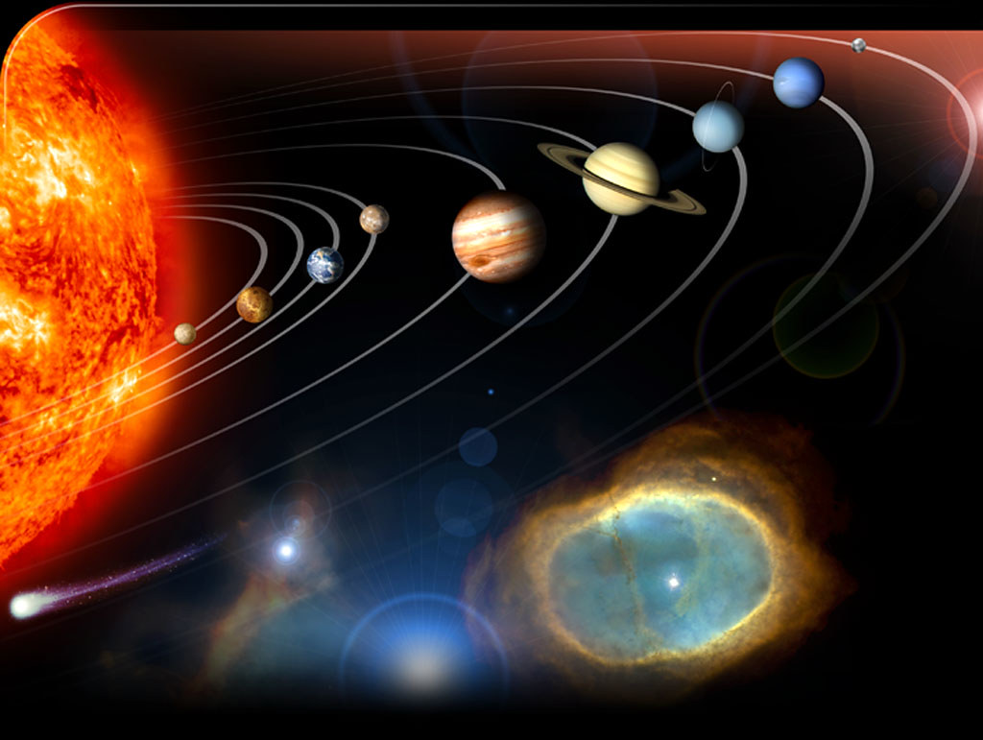
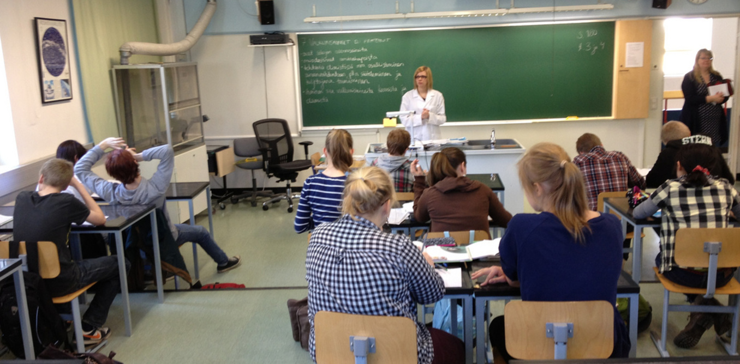
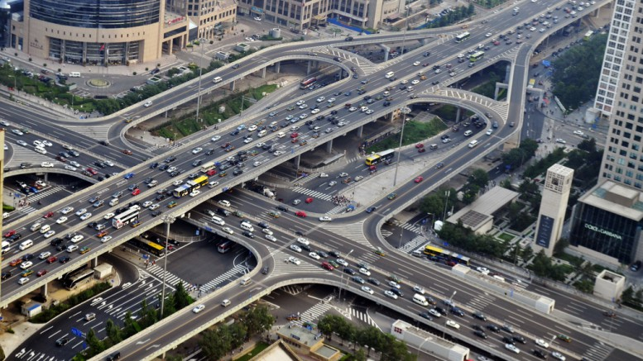

Slide 5
We live in a world of systems nested within systems.
Systems thinking…
Helps us grapple with a world full of complex challenges.
Is a problem-solving approach that emphasizes a complete understanding of interrelationships.

Slide 6
What is the Iceberg diagram?
A metaphor for the process used to examine problems and solutions.
Above the water line of the iceberg is what is visible. Events we experience day-to-day.
Below the water line of the iceberg is what is not so visible.
Here we find patterns, interconnections and people’s perceptions or assumptions.
Investigating below the surface gives you a deeper understanding of the system.

Slide 7
Why Use the Iceberg Diagram?
Using the iceberg diagram as a tool, helps you move from seeing a series of unrelated events to an interdependent, big picture view of the system.
With a deeper understanding, the more opportunity you have to effect change.

Slide 8
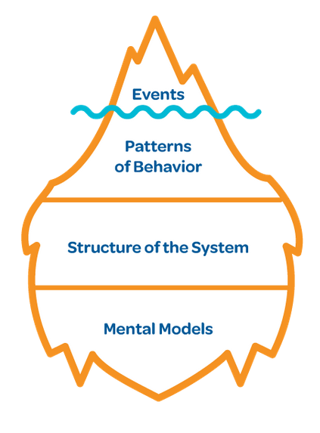
Introduction to Events: What happened? What’s happening?
Picture Book Example:
Who Lives in an Alligator Hole?
Event: “By the 1960s
alligators were on their
way to extinction.”
Because we are curious and want to learn more about why this happened, we venture below the surface …

Slide 9
Introduction to Patterns of Behavior: What changes occurred over time?
Behavior-Over-Time-Graphs (BOTG)
They tell a story!
Kids love to tell their line graph stories!
Help students communicate how and why something changes.
Help students focus on patterns and trends rather than on isolated events.
Analyzing patterns and trends helps to understand reality at a deeper level.

Slide 10
Who Lives in an Alligator Hole? Example: Patterns of Behavior
Behavior-Over-Time Graph
Who Lives in an Alligator Hole?
BOTG Tips
Y-axis
Identifies variable being graphed.
Defined scale can be numeric or descriptive.
High
Low
# of Alligators
X-axis
Is labeled in units of time
Has a defined beginning and ending point
Other elements that changed in the book: insects, fish, birds, mammals, human population, alligator habitat, # alligator holes, etc.
Time (Years)

Slide 11
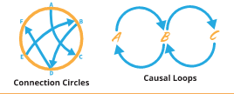
Introduction to Structure What are the relationships among the parts?
The way something is structured within a system will influence how it acts over time.
This can include:
Policies, laws, and physical structures
How parts of a system are organized and interconnected

Slide 12
Who Lives in an Alligator Hole? Example: Structure What are the relationships among the parts?
How are the parts of the system organized or interconnected?
The less alligators, the less alligator holes during the dry season.
The less alligator holes, the less insects, fish and birds.
The less insects and fish, the less birds.
Means changing in the same direction.
Means changing in the opposite direction.
The more development, the less habitat.
The less habitat, the less alligators.
Insects
Alligators
Fish
Birds
Alligator habitat
Land development
Alligator Holes
Connection Circle

Slide 13
Who Lives in an Alligator Hole? Example: Structure
What policies, laws or physical structures influenced the patterns?
Engineers were allowed to build canals and make dams.
Wetlands were turned into farms, roads, malls, houses, and golf courses.

Slide 14
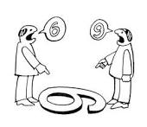
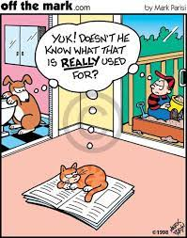
Introduction to Mental Models: What perceptions, beliefs and values do we have?
Mental models are people’s deeply held beliefs.
Mental models are people’s current reality.
Mental models can be difficult to change, yet hold the most power for change.
off the mark by Mark Parisi

Slide 15
Who Lives in an Alligator Hole? Example: Mental Models
What perceptions, beliefs and values did people have about alligators?
“They are scary looking, with big jaws and sharp teeth.”
They are only good for gator wrestling.
They are only good for being made into shoes, purses, and wallets.
They are only good for being fried for supper.
“Wetlands where alligators live weren’t good for much.”

Slide 16
Overview Leverage = Power to Change Events
Alligators no longer endangered
You need a complete understanding of what’s changing and how parts of the system are interconnected in order to make an effective, informed decision.
Understanding the big picture, rather than isolated details
Changing the structure and mental models give you the most leverage, or power to change events.
Number of alligators have increased
Understanding of interconnections; Changing laws
Change peoples’ attitudes and beliefs about alligators.

Slide 17
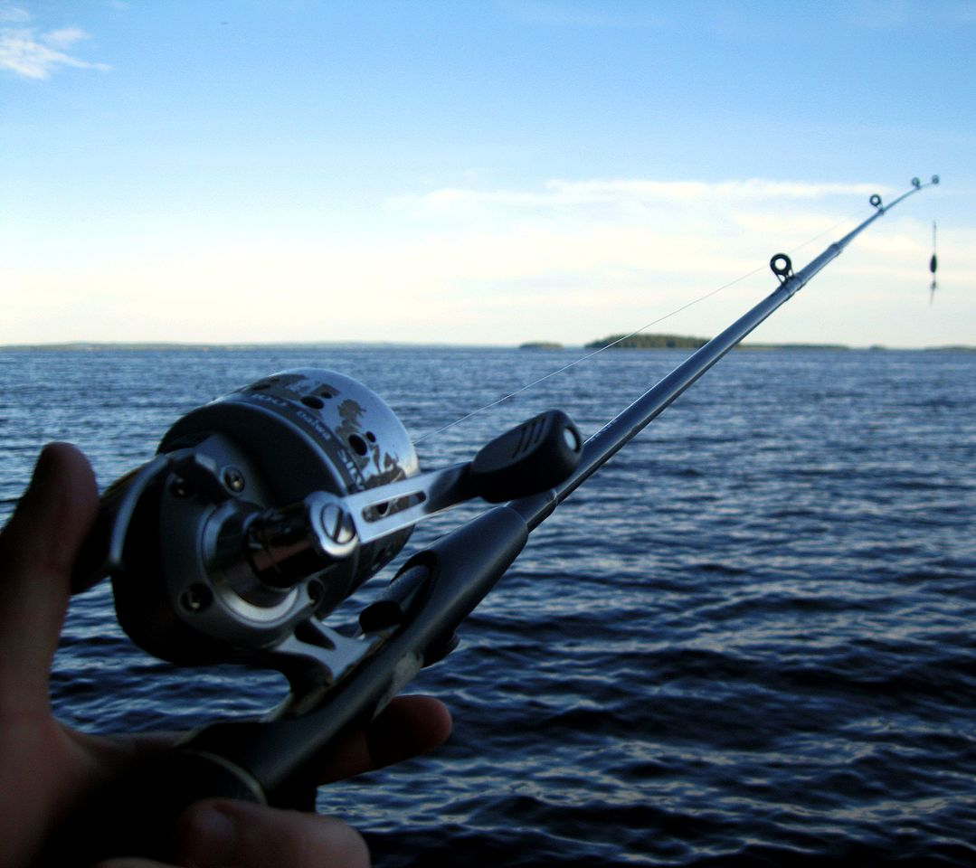
The Fish Game *Adapted from , “Fishing for the Future,” from Facing the Future Through Global Issues
At your tables, divide into 2 groups.
Materials
Each person: Pencil, record sheet, set of chopsticks, spoon
Optional: piece of scrap paper to hold the fish you catch
Each group: Bag of goldfish, ocean (bowl), sticky notes, large piece of paper
Set-up
Count out 20 fish and place in the ocean (bowl).
Place remaining fish aside.

Slide 18
Goal: To have as many fish as possible by the end of season 4.
Steps:
Each person will be a “fisher,” and must catch at least 2 fish per season from an ocean. If you do not catch at least 2 fish, you will sit out the following season.
There are 4 seasons. Each season lasts 20 seconds.
Record each season on the record sheet.
“Technology” will improve each season, making it easier to catch your fish.
At the end of each round, add 1 fish for each fish remaining. There is a carrying capacity (maximum) of 20 fish per ocean.
If 9 fish remain, you may add 9 fish for a total of 18 fish
If 15 fish remain, you may only add 5 fish for the next season.

Slide 19
Start Record Sheet
Season | Starting Number (Fish Stock) | My Catch | Fish Remaining
1 | 20
2
3
4

Slide 20
Round One
Technology: Chopsticks;
One hand behind back

Slide 21
*Count your personal catch and record. *Replenish fish stocks.
Season | Starting Number (Fish Stock) | My Catch | Fish Remaining
1 | 20 | 4 | 8
2 | 16
3
4

Slide 22
Round Two
Technology: chopsticks;
may use two hands

Slide 23
*Count your personal catch and record. *Replenish fish stocks.
Season | Starting Number (Fish Stock) | My Catch | Fish Remaining
1 | 20 | 3 | 8
2 | 16 | 5 | 6
3 | 12
4

Slide 24
Round Three
Technology: spoon

Slide 25
*Count your personal catch and record. *Replenish fish stocks.
Season | Starting Number (Fish Stock) | My Catch | Fish Remaining
1 | 20 | 3 | 8
2 | 16 | 5 | 6
3 | 12 | 5 | 0
4 | 0

Slide 26
Round Four
Technology: Any method

Slide 27
*Count your personal catch and record. *Replenish fish stocks.
Season | Starting Number (Fish Stock) | My Catch | Fish Remaining
1 | 20 | 3 | 8
2 | 16 | 5 | 6
3 | 12 | 5 | 0
4 | 0

Slide 28
What Happened?
Raise your hand if you ended up with a robust fish stock. Healthy? Collapsed?
How did it feel when you realized you had depleted your fish stock?
How did members of your group interact with each other? With other groups in the room?
What caused you to be successful or unsuccessful?
If we played again, what would you do differently?
In order to make an informed decision about what to do differently, we need to learn more about the system we were playing in.

Slide 29
Fish Game Application: Events What happened? What’s happening?
Event: Our fish stock collapsed.
Because we are curious and want to learn more about this event, we venture below the surface …

Slide 30
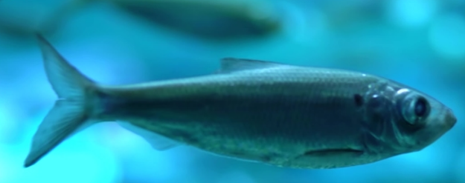
Fish Game Application: Patterns of Behavior: What changed throughout the 4 seasons?
At your table:
Brainstorm as many variables/ elements that changed (increased or decreased).
Concrete (quantities, e.g., population) or abstract (e.g. pressure or stress)
Write each variable on a sticky note, vertically, on a y-axis.
Examples:
Total fish caught
Fish stock
Number of “fishers”
Fishing technology
Speed of catching fish
Efficiency of catching fish
Competitive pressure
Effective communication
between “fishers”
Total Fish Caught

Slide 31
Fish Game Application: Patterns of Behavior: How did the variables/elements change?
At your table:
Choose a sticky note to work with.
Label the X-axis with Seasons 1-4
Competitive Pressure
Total Fish Caught
2 3 4
Season
2 3 4
Season

Slide 32
Fish Game Application: Patterns of Behavior How did the variables/elements change?
Competitive Pressure
GRAPHS TELL STORIES!
At Your Table:
High
Competitive Pressure
Draw a line graph to tell the story of your variable over the 4 seasons.
Example: Competitive Pressure
There’s a story behind each peak and valley.
Different interpretations of the behavior of the variable are possible.
Similarities and differences among graphs are grounds for rich discussion.
Low
2 3 4
Season

Slide 33
Fish Game Application: Structure How are the variables/elements (parts of the system) interconnected?
Total fish caught
Fish stock
Number of “fishers”
Fishing technology
Speed of catching fish
Efficiency of catching fish
Competitive pressure
Effective communication
between “fishers”

Slide 34
Number of “fishers”
Fish Stock
At Your Table:
Work together to make a connection circle:
Draw a circle on the paper in front of you.
Place sticky notes with your behavior-over-time graphs around the circle.
Fishing
Technology
Speed of fishing
Efficiency of fishing
Total fish caught per season
Competitive pressure
Communication between
fishers

Slide 35
Connection Circle
Number of “fishers”
At Your Table:
Fish Stock
Find a direct cause and effect relationship.
Draw an arrow from the “cause” element to the “effect” element.
Each arrow you draw shows how one element causes a change in another element.
The more, the more
The less, the less
The more, the less
The less, the more
Fishing Technology
Speed of fishing
Total fish caught per season
Efficiency of fishing
Competitive pressure
Effective communication between fishers

Slide 36
Fish Game Application: Mental Models What perceptions, beliefs and values do we have?
Goal: To have as many fish as possible by the end of round 4.
“I should be conservative and only get what I need.”
“I should go as fast as possible to beat others to the fish.”
“The goal is to have more fish than others by the end of the game.”
“Our livelihood depends on a healthy fish stock.”

Slide 37
Overview Leverage = Power to Change Events
Healthy Fish Stocks
You need a complete understanding of what’s changing and how parts of the system are interconnected in order to make an effective, informed decision.
Understanding the big picture, rather than isolated details
Changing the structure and mental models give you the most leverage, or power to change events.
Fish stocks increase and decrease, but never go below 10.
Understanding of interconnections;
Change fishing regulations
We should work together to only get fish we need.

Slide 38
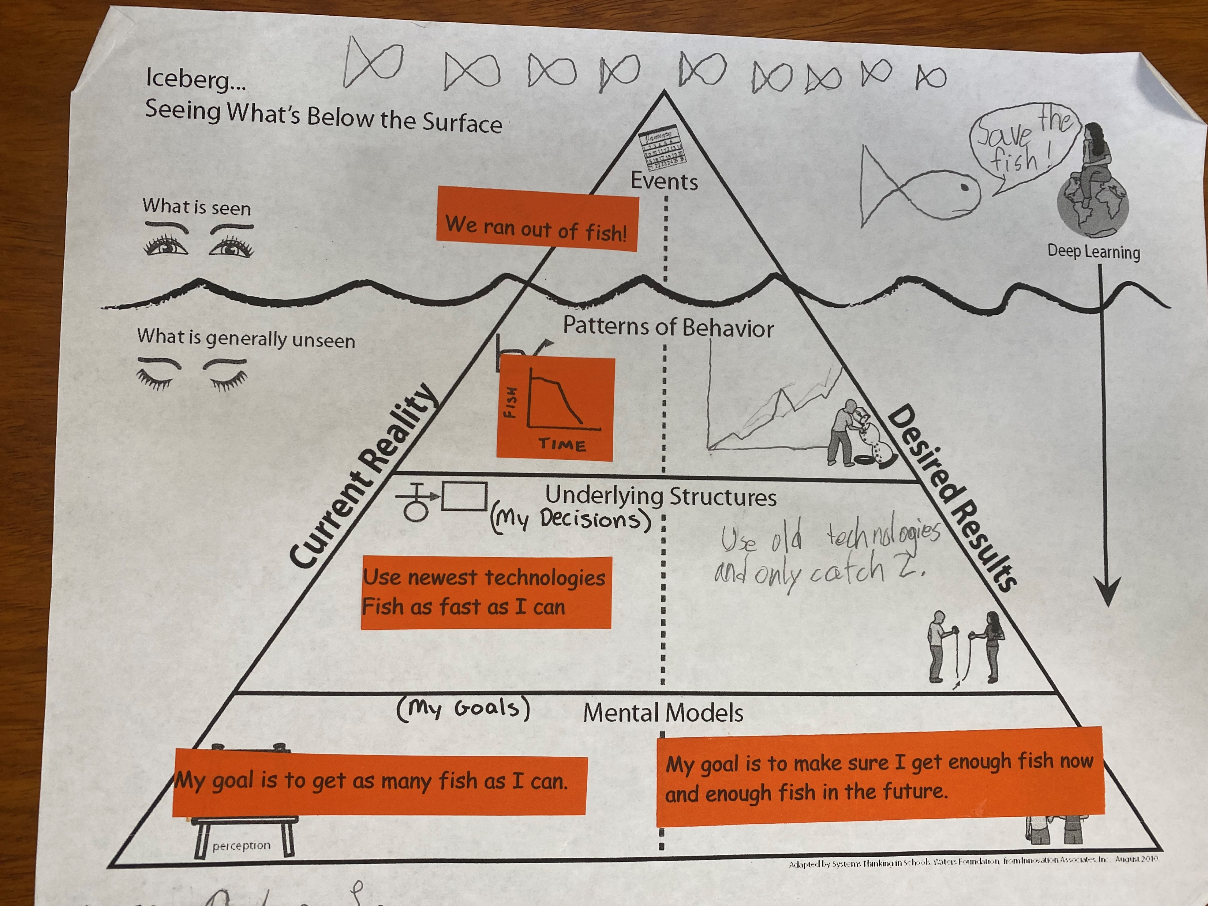
Sample Student Work
Iceberg of the Fish Game
Third grade
Desired Results “Structure”
“Use old technologies and only catch 2 [fish].”

Slide 39
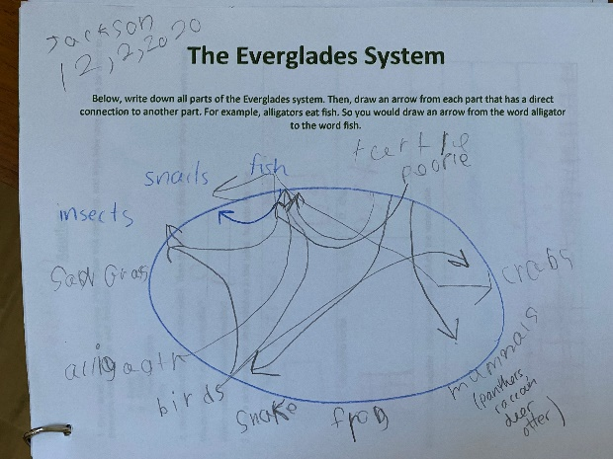
Connection Circle for Everglades by Jean Craighead George; 2nd grade

Slide 40
Panther Investigation; 4th grade
BOTGs
Human population
Car accidents
Panther health
Habitat loss
Hunting
Iceberg Diagram, Connection Circle, BOTGs

Slide 41
Final Book Project: Iceberg Diagram; 4th grade group work

Slide 42
Mental Models Over Time: Everglades
“All plant and animal and human life is connected, and it is important to respect all forms of life and live within the natural life cycles of the Everglades.”
Miccosukee belief
“Home to the alligator and the otter, the sea turtle and dolphin, the panther and manatee, while also serving as the drinking water supply for nearly 9 million south Floridians, the Everglades are a treasure that belongs to all Americans and to the world.”
Everglades Foundation
The Everglades is a “worthless swamp.”
Sentiment of many settlers and developers
“Conservation doesn’t mean preserving the land. It means using the land wisely to benefit the greatest number of people.” Draining the Everglades would be, “The greatest conservation project in the United States.”
John Gifford, Conservation magazine
Water in the Everglades needs to be controlled to help farmers.
President Roosevelt’s Reclamation Act

Slide 43
Resources and Final Thoughts
Waters Center for Systems Thinking
https://waterscenterst.org/
Thinking Tools Studio for self-guided study
Free monthly webinars
Lesson plans and templates
Education, as well as healthcare, early childcare, nonprofits, governments, and corporations
Creative Learning Exchange
http://www.clexchange.org/
Focus specifically on K-12 education
Heavy focus on systems dynamics and computer modeling
Lesson plans, online simulations

Slide 44
Steps to Inspiring Passion:
Curiosity is the starting point of learning and the invitation to explore.
Exploration is the activity of taking the time to pursue the answers to the questions that your curiosity raises.
Discoveries are a natural outgrowth of exploration, distinguished by a moment of sudden awareness.
Sharing is the affirmation of discovery.
Passion is the feeling associated with a profound commitment to act.
Passion develops when you are willing and able to give back.
Compiled from Teaching Kids to Love the Earth (1991)

