Slide 1
EVERGLADES ECOQUEST
Notes:
https://www.youtube.com/watch?v=ZPNKEAGpZYk

Slide 2
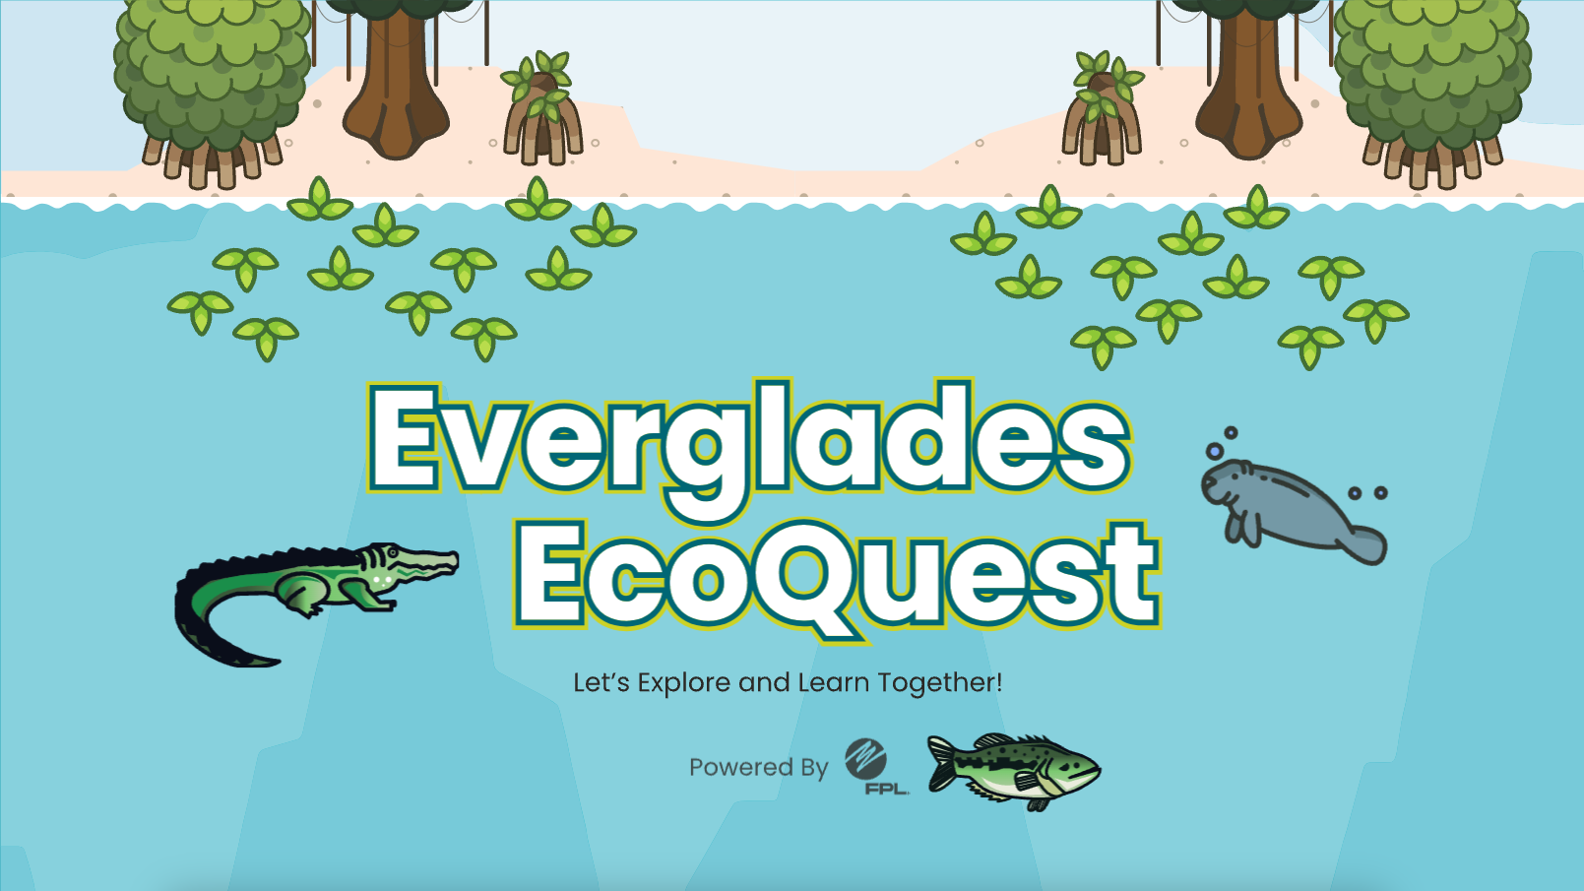
EVERGLADES ECOQUEST
Notes:
Agenda/List page type 2

Slide 3
Everglades Ecoquest
Free web-based learning platform for all ages
4 Quests, aligned to Florida Standards
Text, videos, quizzes, and games
Badges earned after each lesson
Water droplets are earned in quizzes and used for extra lives
Notes:
Agenda/List page type 2

Slide 4
Login Access
Students will enter their unique code.
No personal registration info is required.
Notes:
Agenda/List page type 2

Slide 5
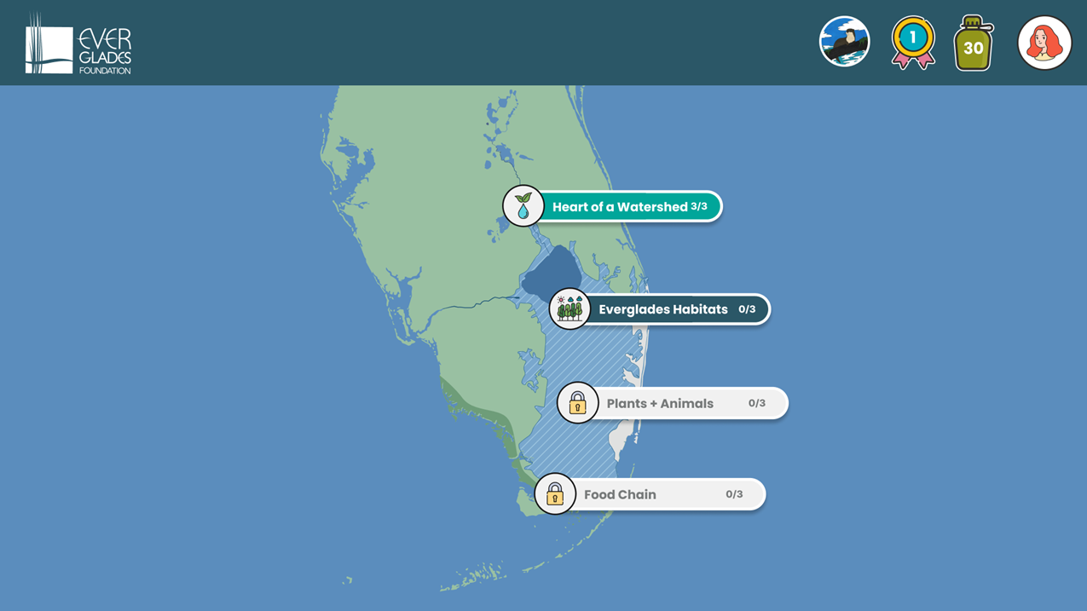
Navigation Map
Students are presented with a map of the Everglades with clickable/touchable areas to explore. As new lessons and content are added to the application, the number of interactive areas will grow.​
Notes:
Agenda/List page type 2

Slide 6
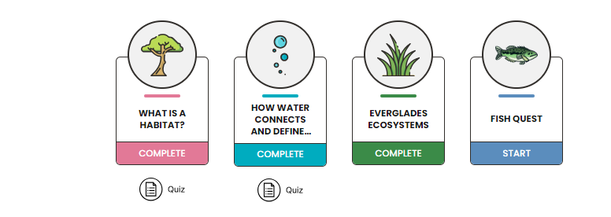
Exploring Lessons
Once a top-level lesson is selected, the student will be taken into the lesson plan to learn through a combination of educational content and interactive quizzes to test their knowledge.
Notes:
Agenda/List page type 2

Slide 7
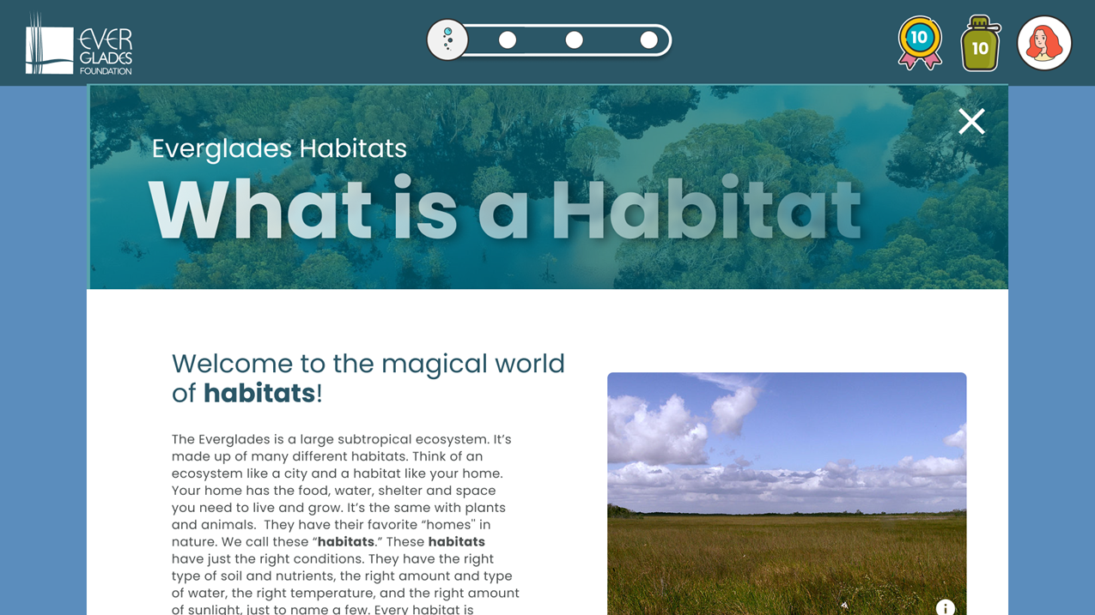
Lesson Content
Lesson content can take shape in a variety of formats including text, imagery, and video.
Notes:
Agenda/List page type 2

Slide 8
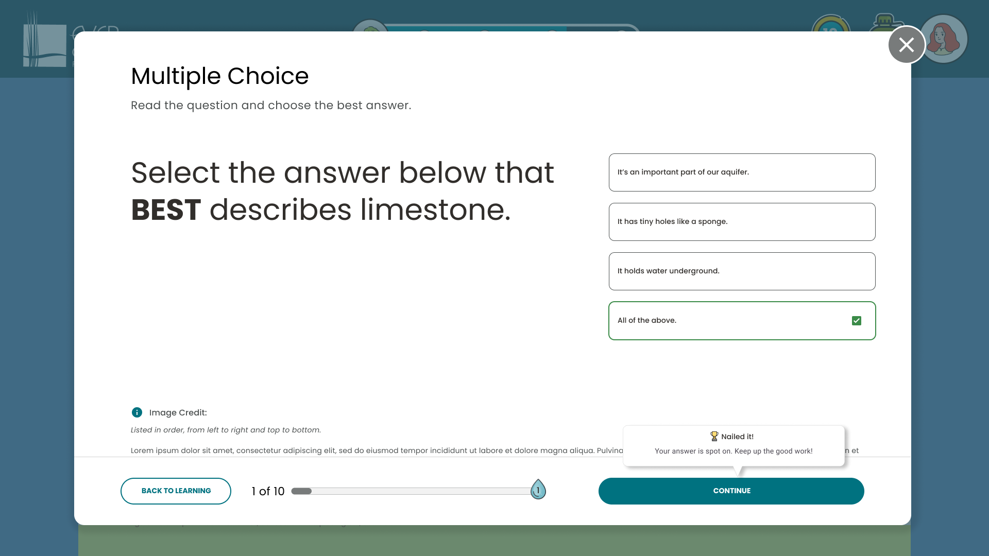
Test Your Knowledge
Each lesson is followed by an engaging, interactive quiz designed to test the students’ knowledge about what they have just learned. Style and complexity of quizzes and test information will change based on the lesson and student age.

Slide 9
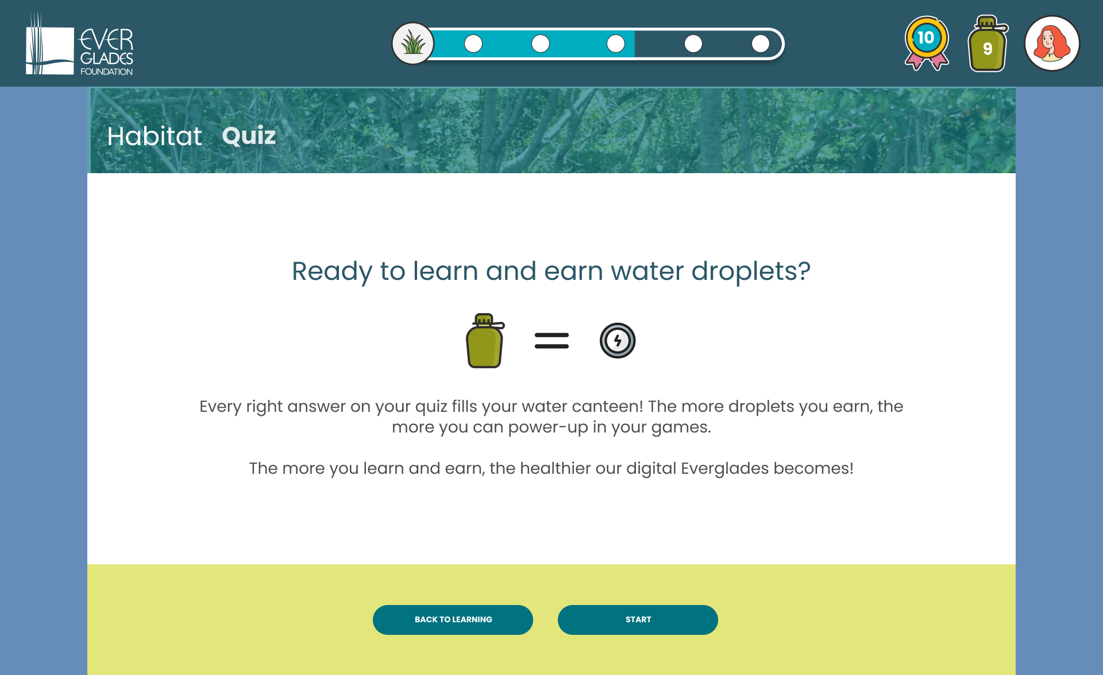
Earn Power-Ups
By answering questions correctly, students will earn points in the form of water droplets. These water droplets can be used to progress through games later in the application—while also reinforcing a sense of how to make the Everglades a healthier ecosystem.

Slide 10
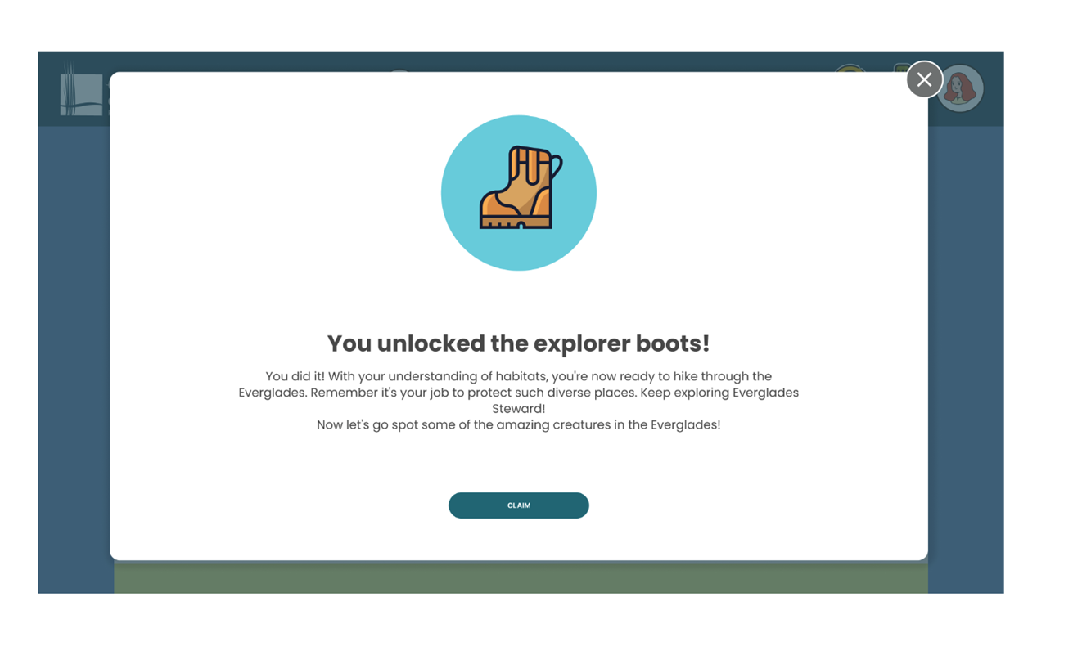
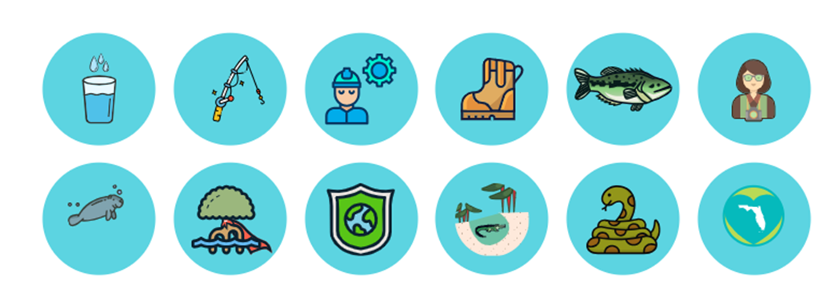
Rewards and Recognition
Upon successful completion of a lesson plan and passing the quiz, students will earn and collect digital badges.

Slide 11
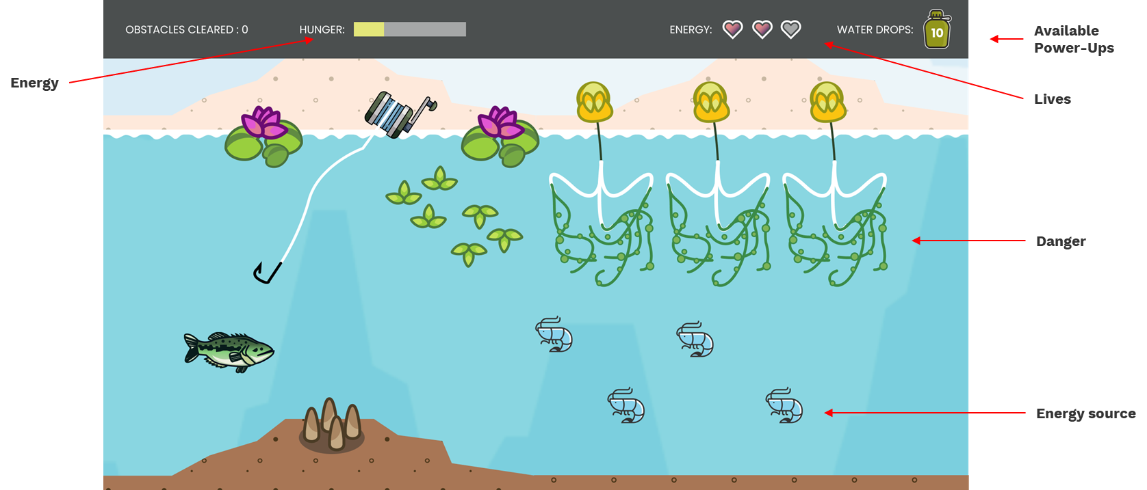
Interactive Games
Upon completion of a lesson and its quiz, students are presented with the opportunity to play an optional, interactive game. It’s their chance to explore the Everglades while testing their skills.

Slide 12
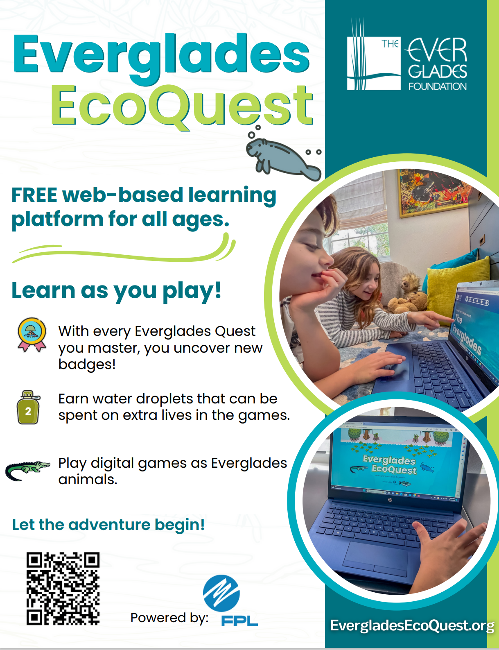
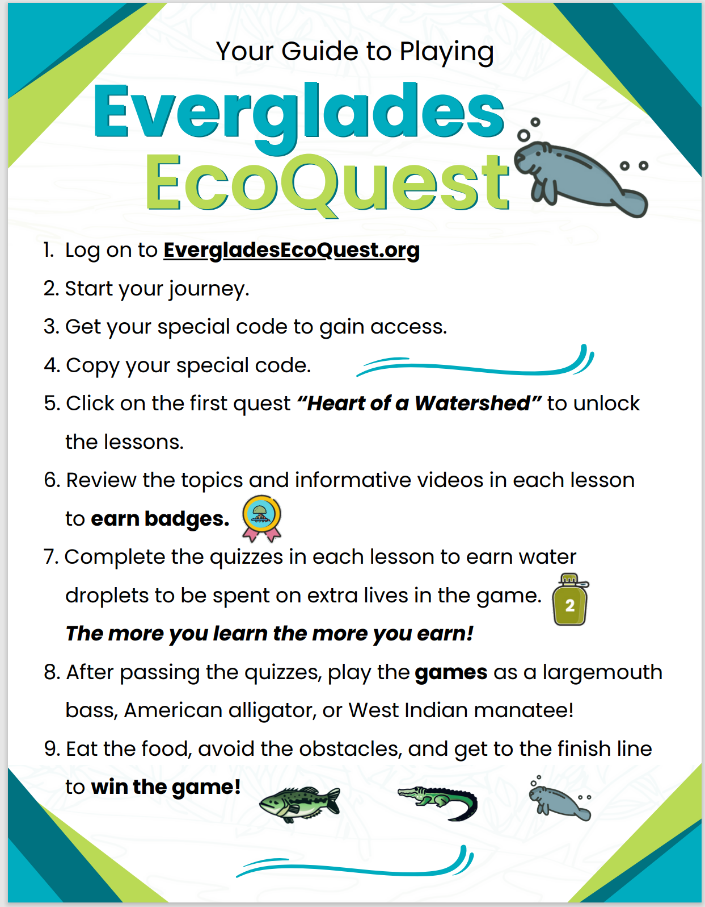
Notes:
Agenda/List page type 2

Slide 13
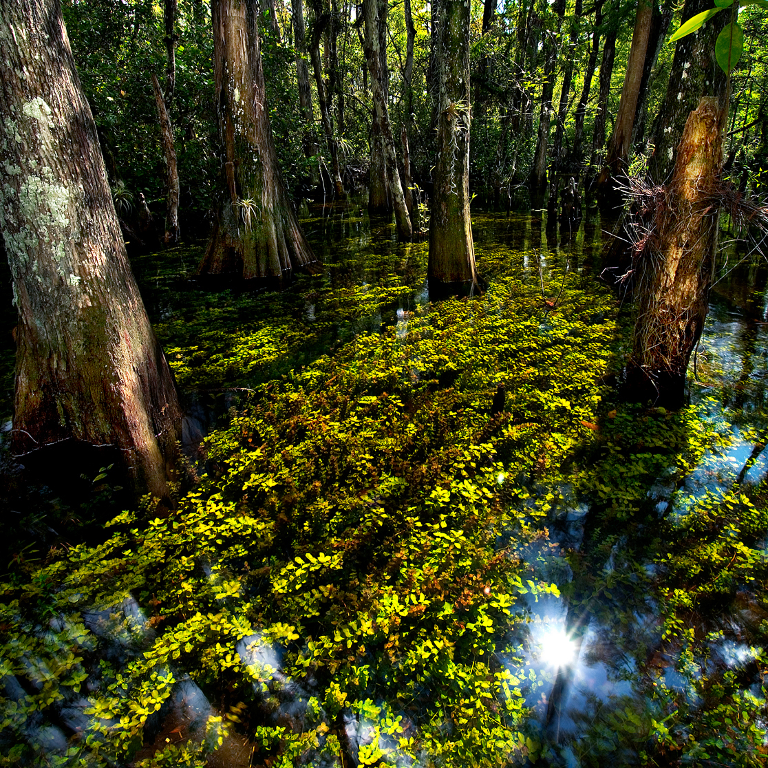
THANK
YOU
Website: www.evergladesliteracy.org
Email: education@evergladesfoundation.org
Follow and tag us on social media:
Facebook: @EvergladesLiteracyProgram
Instagram: @EvergladesFoundation
Twitter: @TeachEverglades

